Slide 1
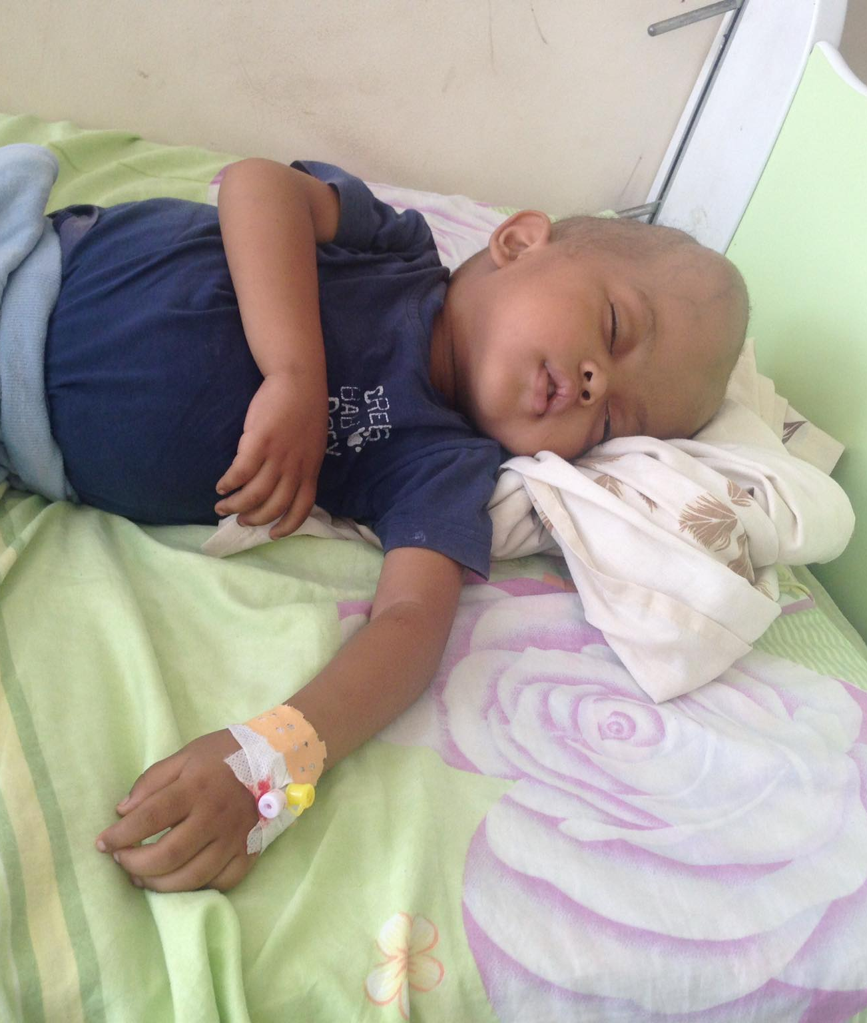
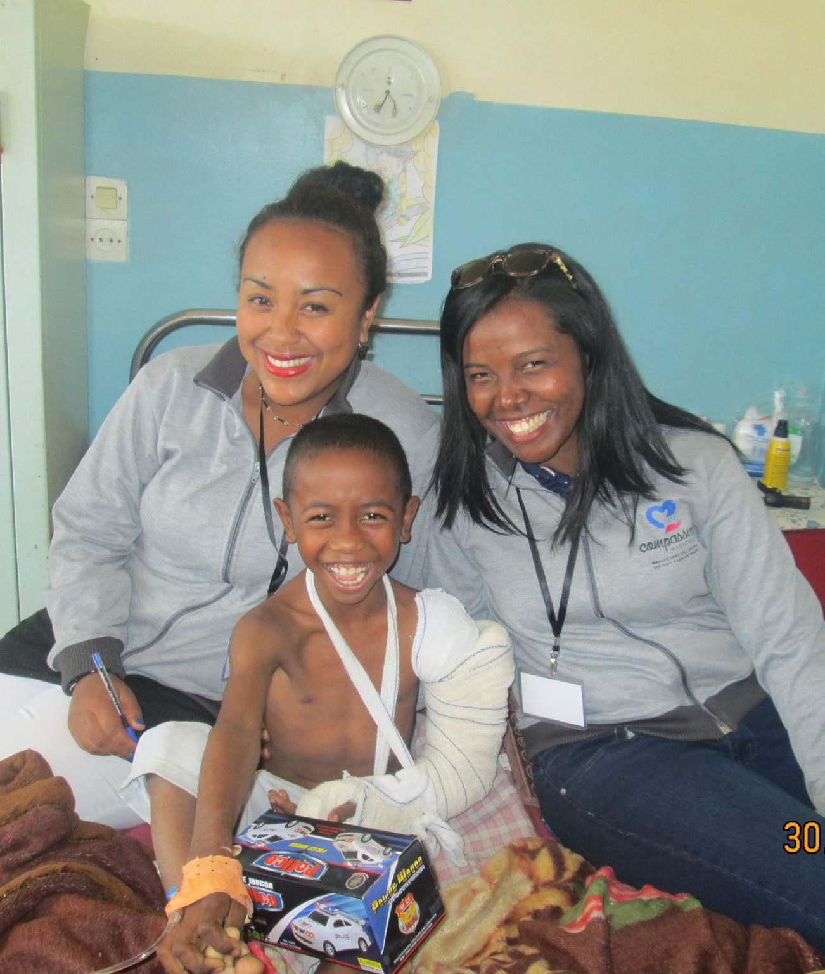
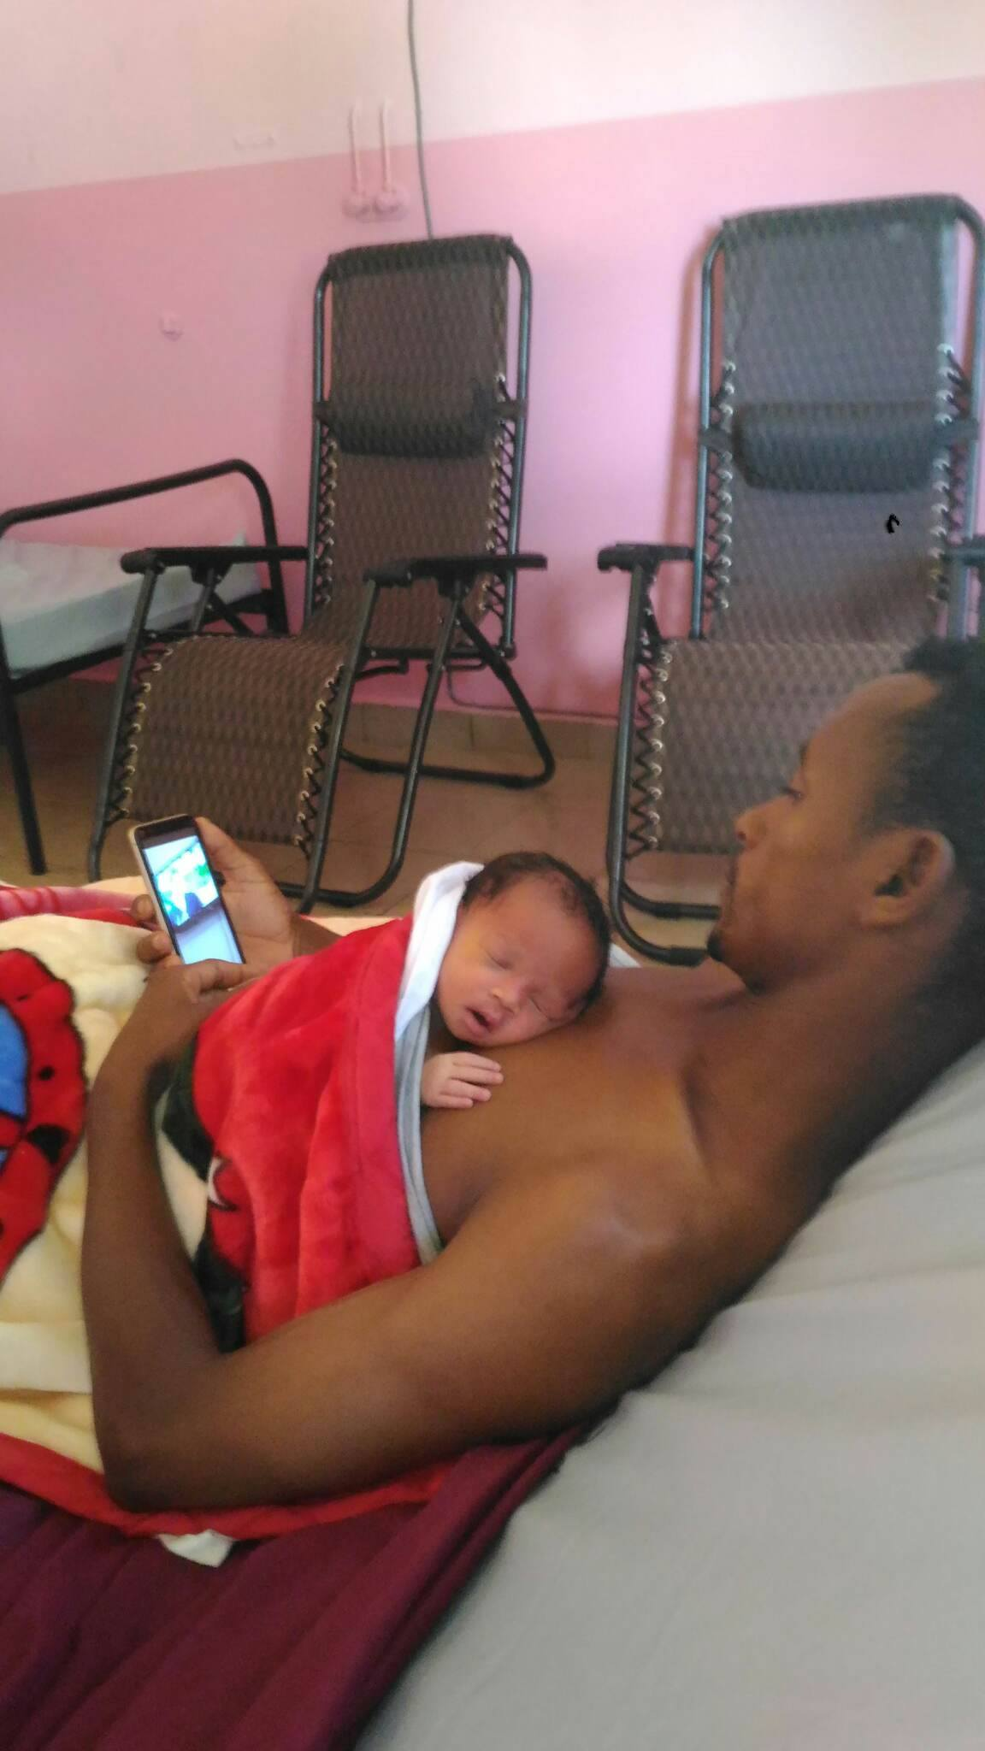

COMPASSION MADAGASCAR
All they asked was that we should continue to remember the poor, the very thing I had been eager to do all along. Galatians 2:10

Slide 2
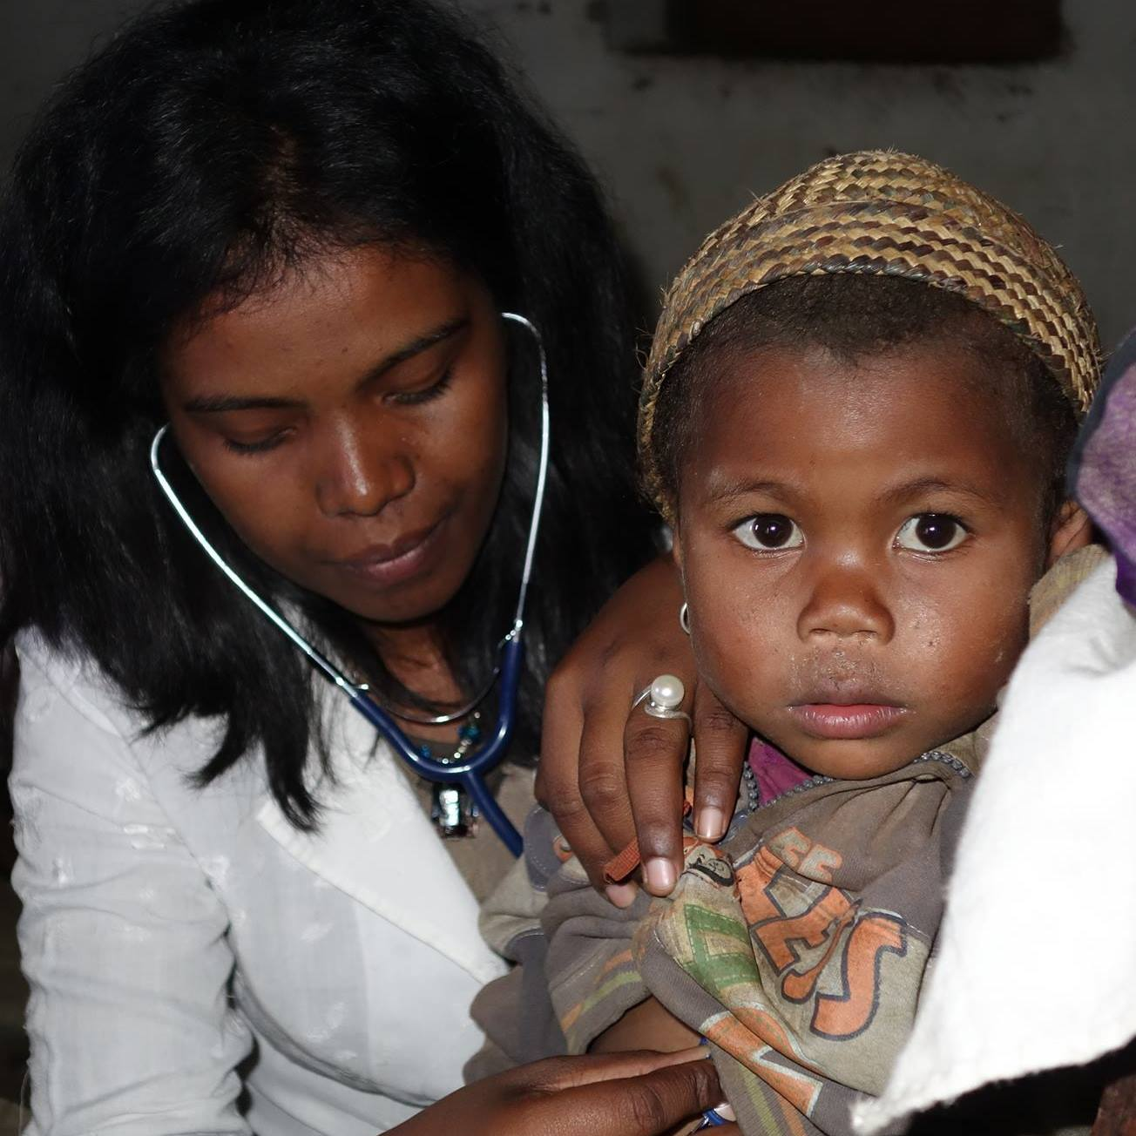
WHY COMPASSION MADAGASCAR ?
In 2010 I (Elodie) was 20 years old in my 5th year of medical school doing my pediatric training, the painful reality of poverty and inequality in accessing healthcare inspired me to start a movement of saving children’s lives. This is where Compassion Madagascar started
Like many other young people in low-income countries, I had the dream of moving to a rich country far away from misery but it was hard for me to close my eyes to the children in need so it became my life mission. I chose to stay in Madagascar to help distressed parents whose children need financial support to receive the treatments they need.

Slide 3
THE REALITY IN MADAGASCAR HOSPITAL
Public hospital : only hospital beds are free; consultation, medical exams, treatment and food have to be paid out-of-pocket.
90 % of the population in Madagascar go to public hospital expecting care to be free of charge. When faced with the cost of care, families often have to sell their assets (sewing machines, TV screen, motorcycle, etc). Sometimes, by the time they manage to sell their things, it’s unfortunately too late. As a result, many people die from preventable illnesses and injuries.
Unbearable care costs can even result in homelessness, I personally know of 2 cases in 12 years now.

Slide 4
Our Projects
Sunshine : providing financial support to hospitalized children and pregnant women so that they can receive adequate care
Kangaroo Mother Care Center: a special center for maternity and pediatric ward to practice kangaroo care which is the best way to save the lives of preterm babies or new born with low weight.
Education for all: providing financial support for education-related charges

Slide 5
Sunshine
’’shining a light of health in the dark world of disease’’
Our office is at the Pediatric Ward University Hospital Befelatanana, Antananarivo. It is open everyday to receive parents from 5 hospitals who bring their prescriptions. Their needs are often urgent but we don’t always have the medicines they need or the money to buy it.
We raise funds to support these families through our social media pages everyday. Everyday we hope that generous hearts will respond to our call for donations.
We also provide meals everyday for the children and parents.

Slide 6
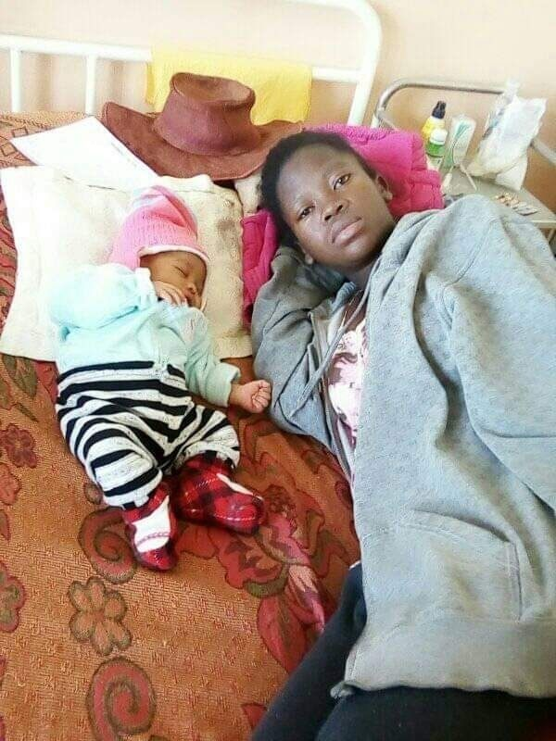
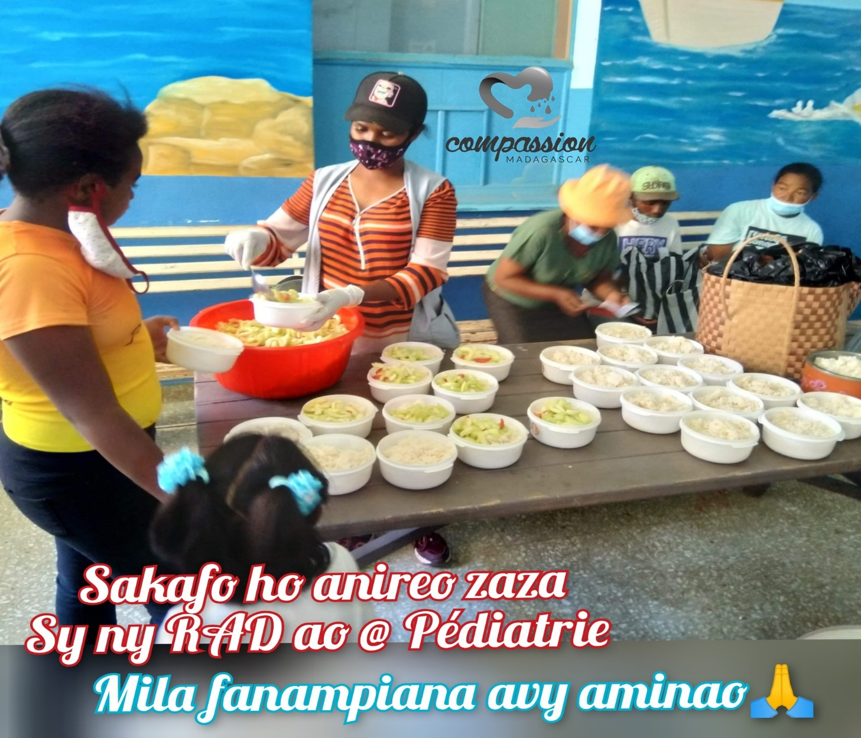
1800 meals per month for children and their parents at the hospital every day
Support for mothers during childbirth

Slide 7
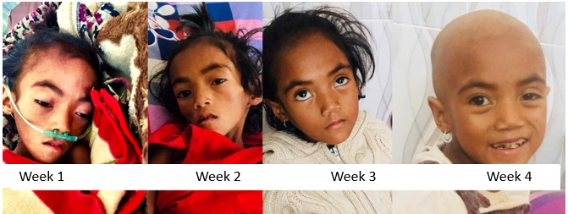
Success Story
Sidonie, a 6-year-old girl, came from a village 80 km away from Antananarivo. We were visiting another child close to the room where she was admitted when the cleaner approached us and said, there is a little girl who wait for your compassion on the other side, please see her before you leave. We saw her with her mom in desperate need for help. Her mom told us they had no more money even for food and that her daughter was dying. Sidonie was diagnosed with nephroblastoma. We told her we would try everything we could to get what she needed for her treatment. Only a month later, after going through chemotherapy and surgery, Sidonie would give us her brightest smile. Her health was restored, and this is our greatest satisfaction.

Slide 8
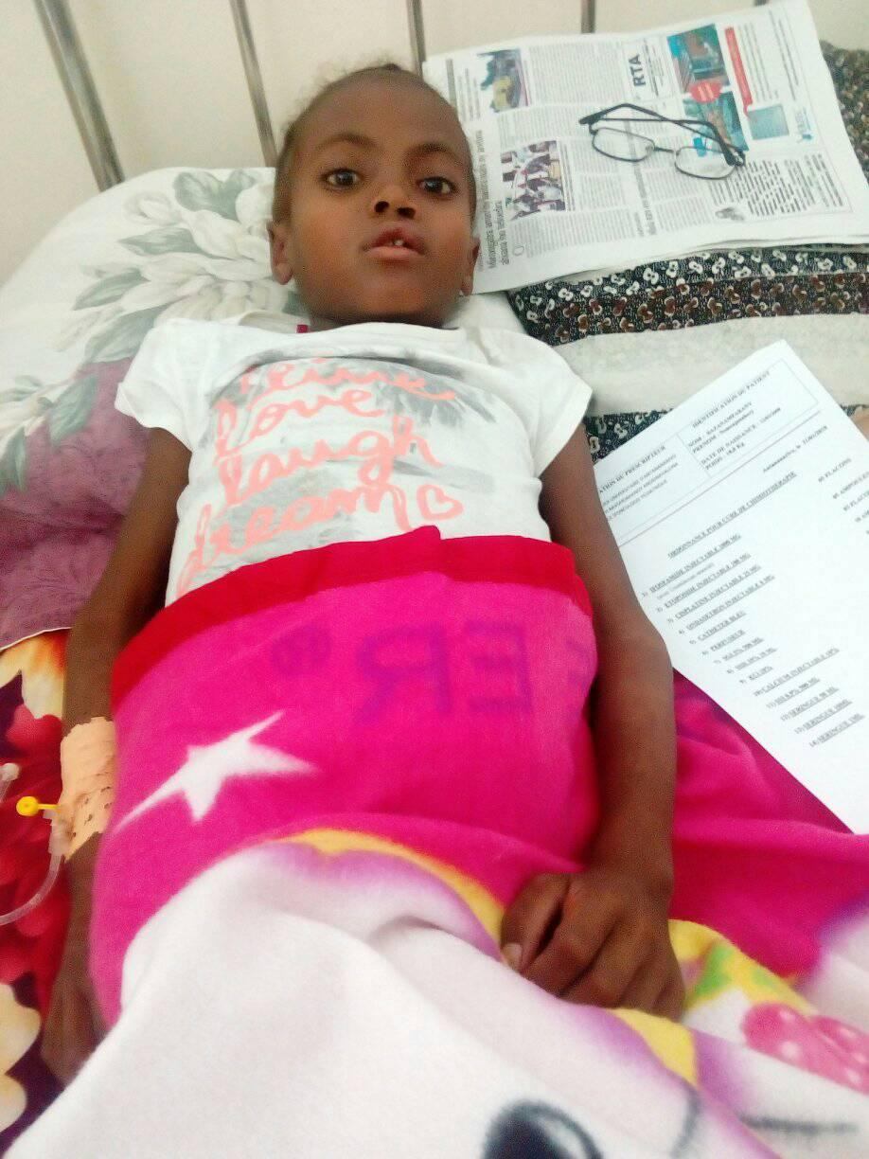
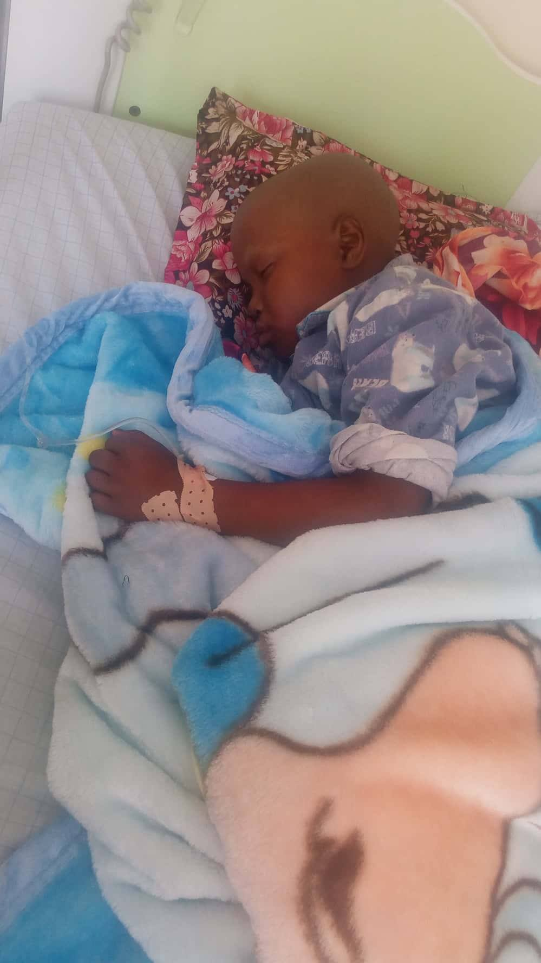
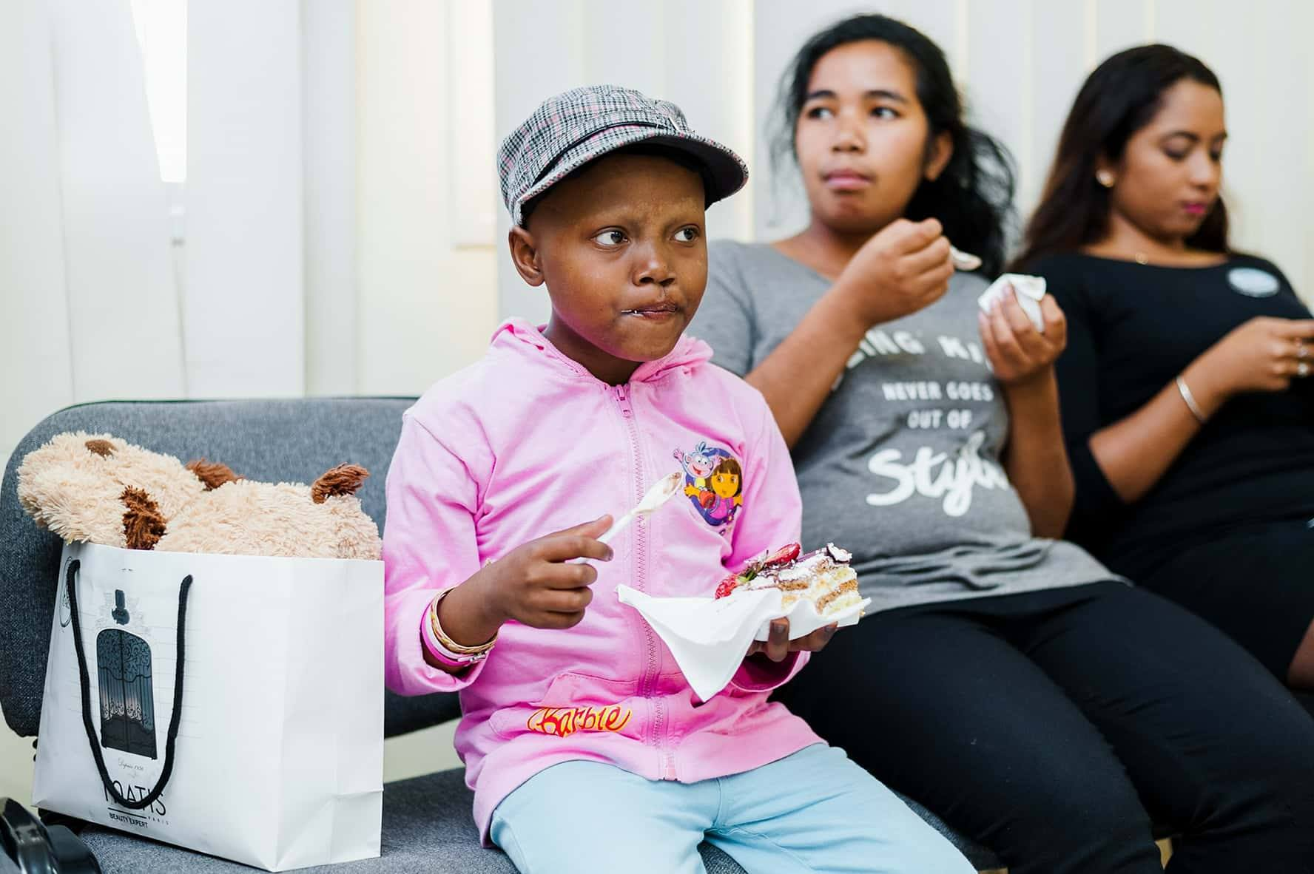
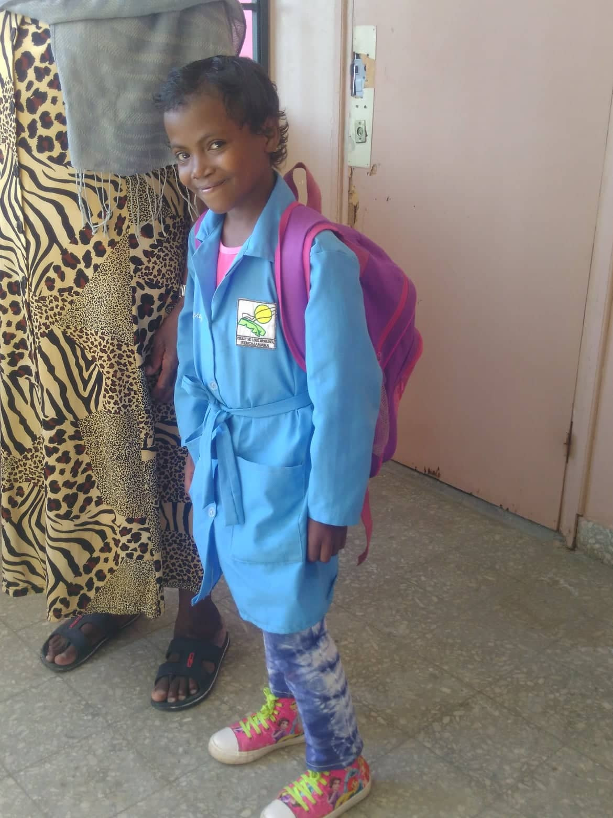
MENJA (10 years old), in 2018, she suffered from uterine cancer. Raised alone by her grandmother who had no means for hospital care. It was her neighbor who contacted Compassion. She went through a dozen chemotherapy sessions and surgery (she has no more uterine) and was released after a year of treatment (cost of care around 16 million Ariary).
Currently in grade 9 at school. She is the best of her class, sponsored by a Malagasy family who has provided their rent, food aid and school fees for 2 years now.

Slide 9
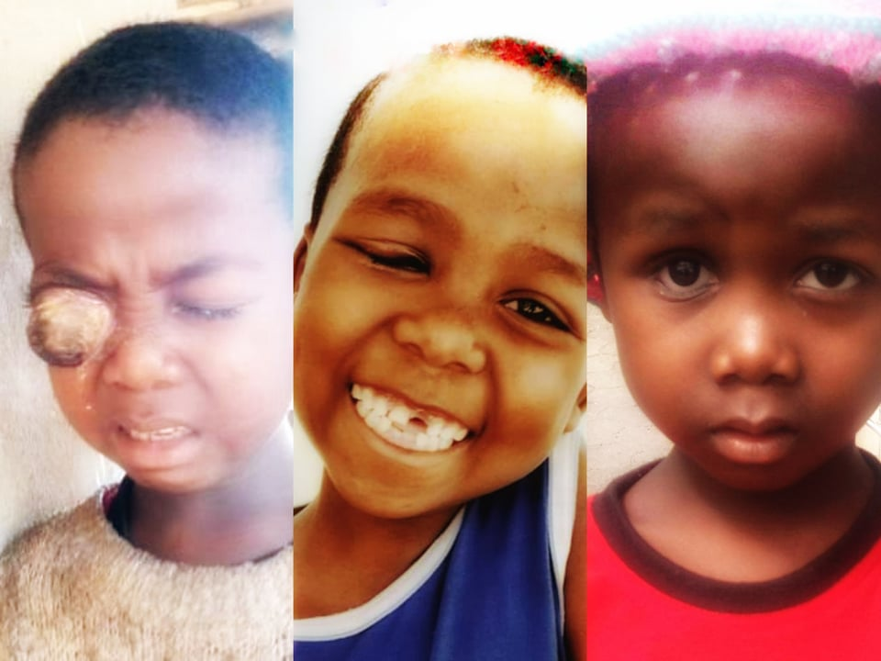
SEBASTIEN (7 years old) in 2020, coming from a village near Fianarantsoa. He was crying all the time because of the pain from his sick eye and someone who went on a mission to his village who contacted Compassion and sent the first photo. He was treated for 8 months in Tana with chemotherapy sessions and surgery and finally an ocular prosthesis. His right eye can no longer see but he is fine and happy. He smiled again and that is our joy. (Support cost around 10 million ariary)

Slide 10
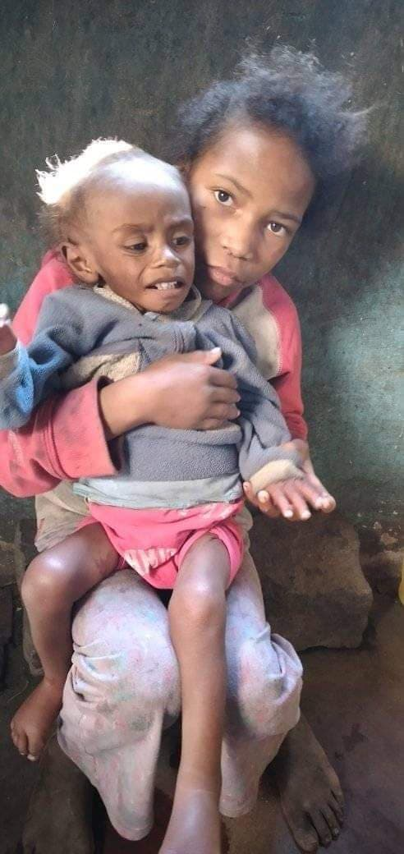
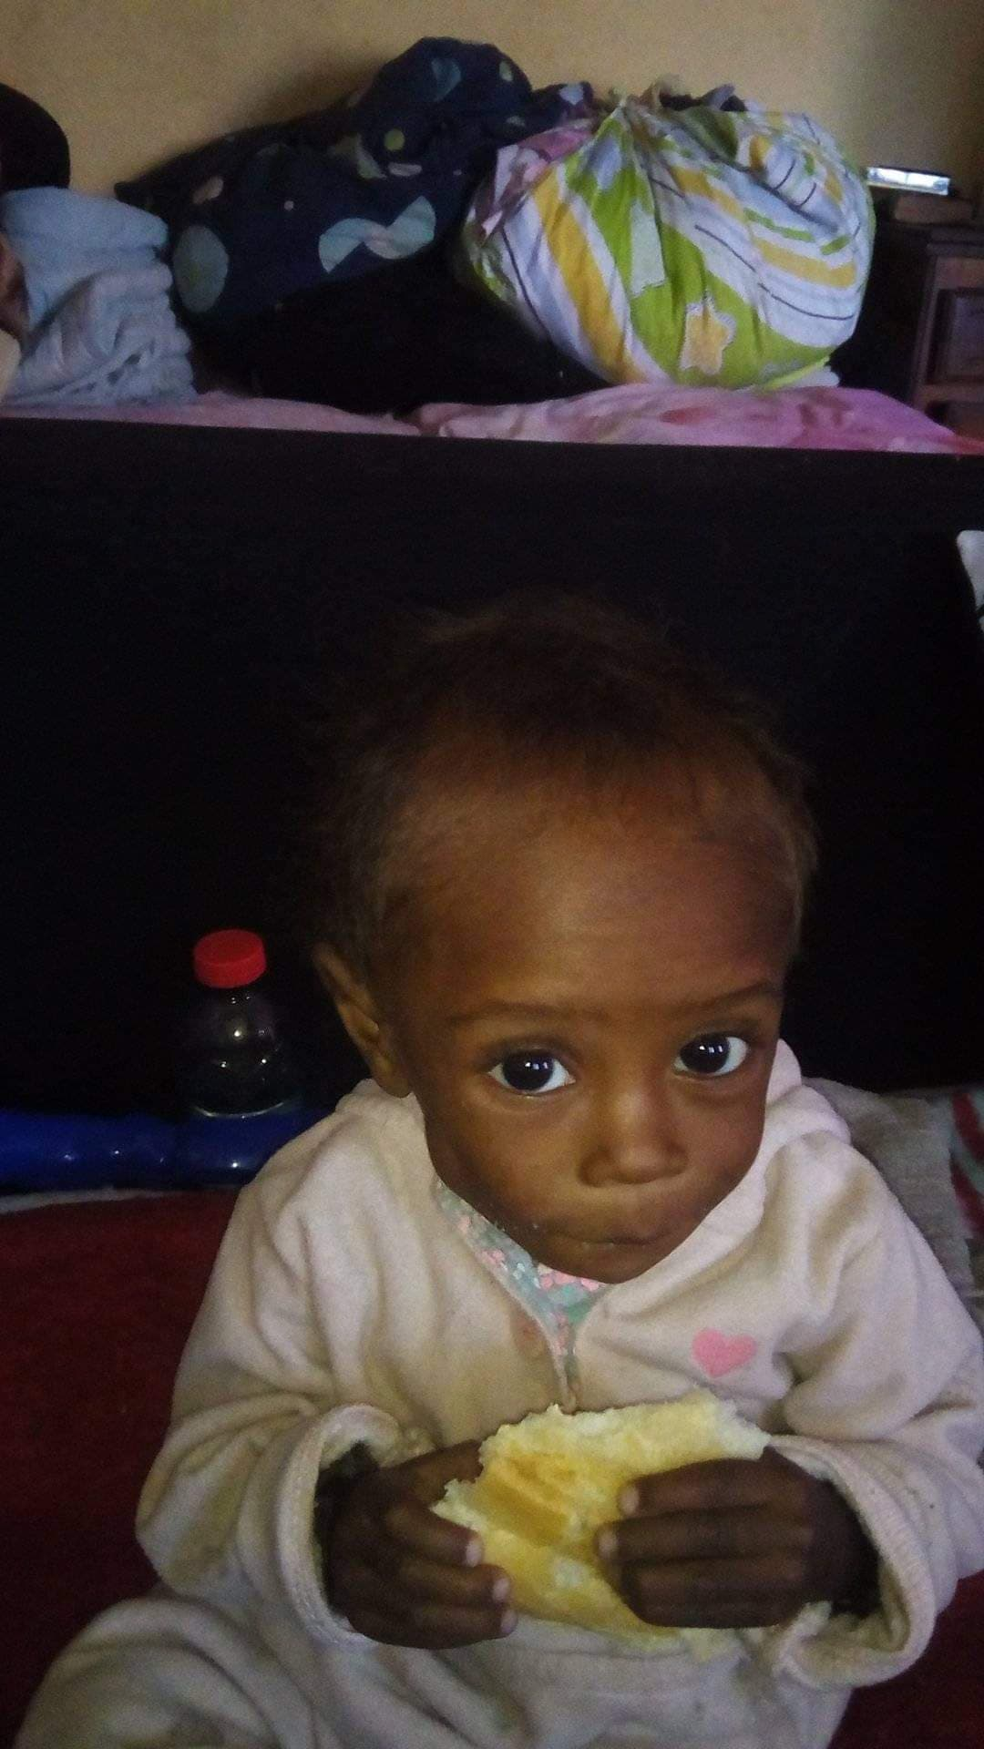
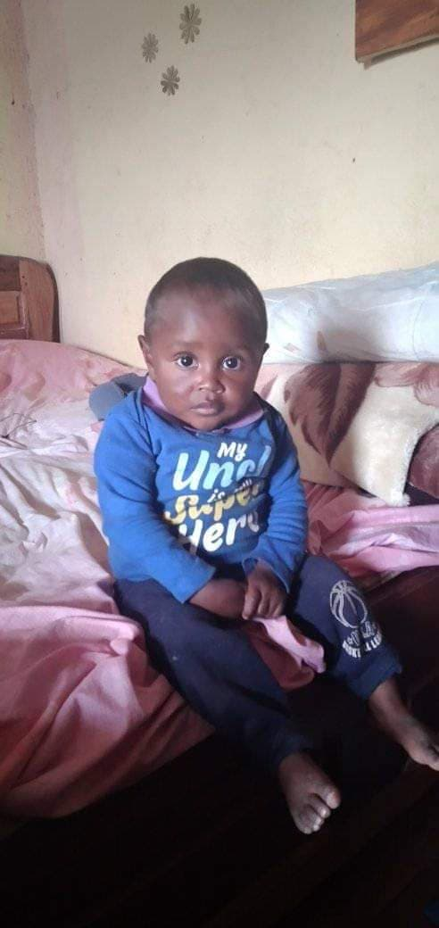
Fitahiana 2 years and 2 months,Street little boy saved by grace. having suffered from severe malnutrition where he weighed barely 4kg. food aid has been provided on a regular basis through the sponsorship program for 8 months now.

Slide 11
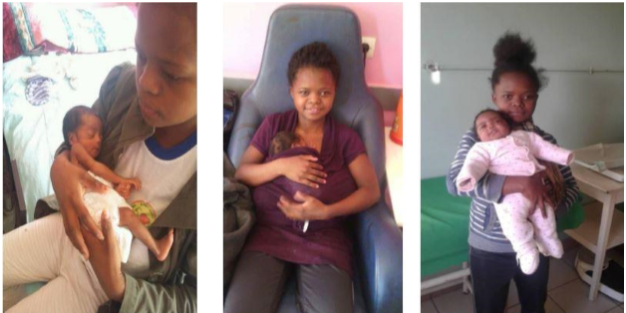
MALALA, 700g birth weight, 3900g after 4 months, she did Kangaroo Mother Care
She was taken care of in the Mummy Kangaroo Center of the military hospital that we implemented on March 1, 2018.

Slide 12
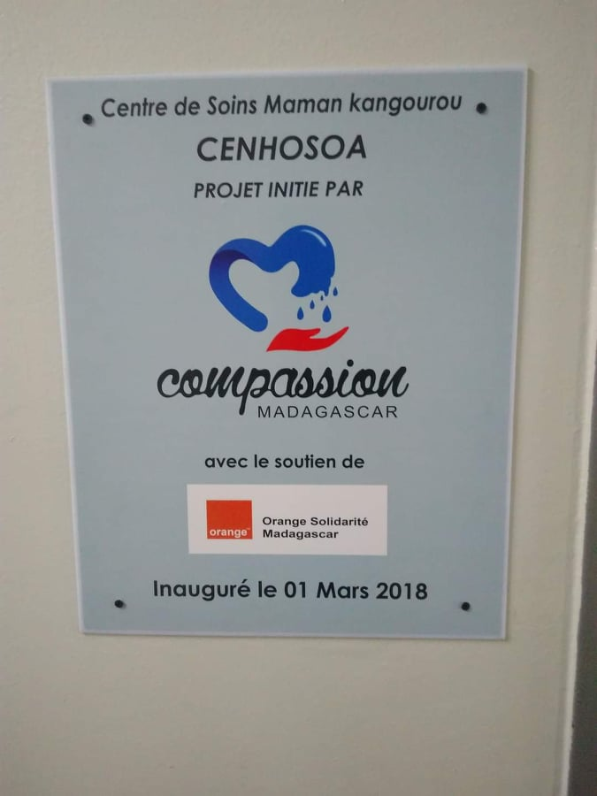
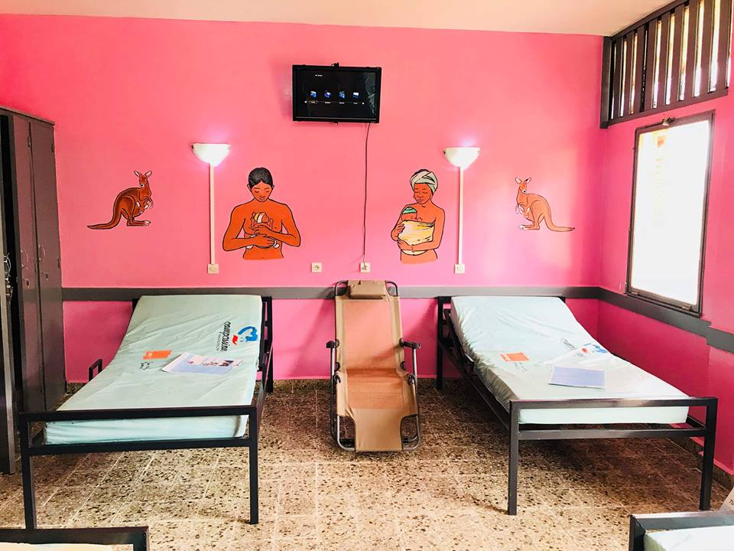
Setting up a mother kangaroo care center with 5 beds costs around 20million Ariary and that is the price of one incubator.

Slide 13
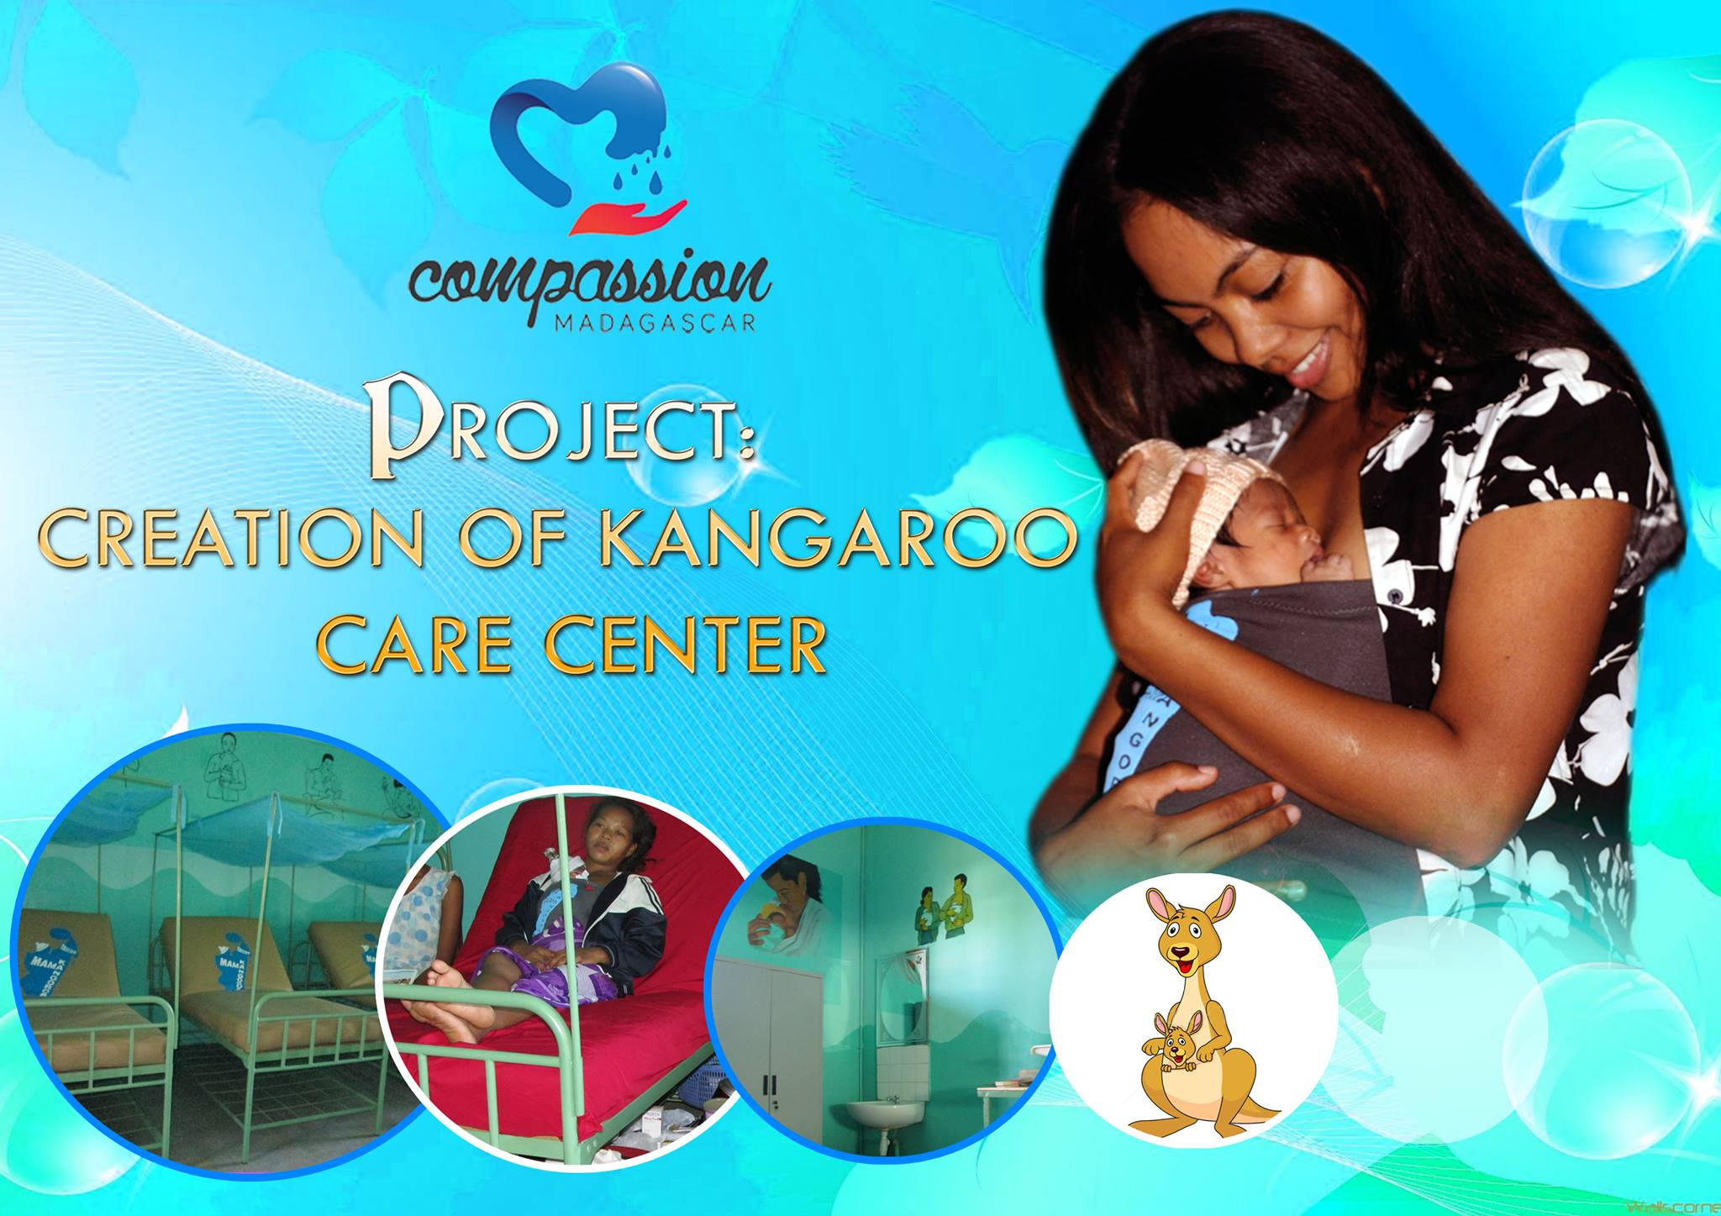
KMCC Kangaroo Mother Care Center
One of the major issues pediatric wards and maternities are facing is the lack of medical devices including incubators. In Madagascar, we typically just place bottles of hot water around the babies. KMC is not well-known although it has proven much better than incubators based on many research.
I studied about this care system in Bogota, Colombia in 2012 and from then on, we have been promoting it. Good nutrition and good temperature are required for the little babies to grow well in weight.

Slide 14
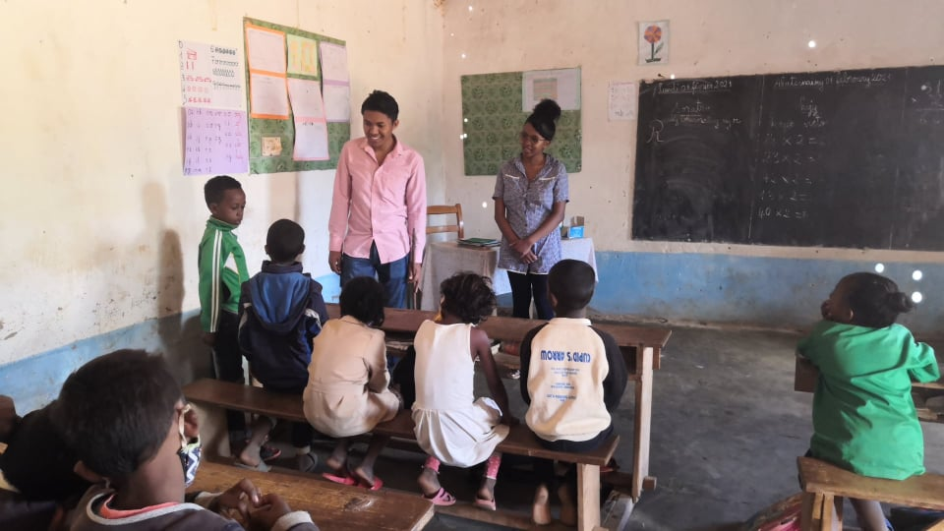
Support for 130 children at Primary Public School Ambatomena
French lessons (in the morning)
Reinforcement of the 7th grade class (Afternoon)
One Meal / day

Slide 15
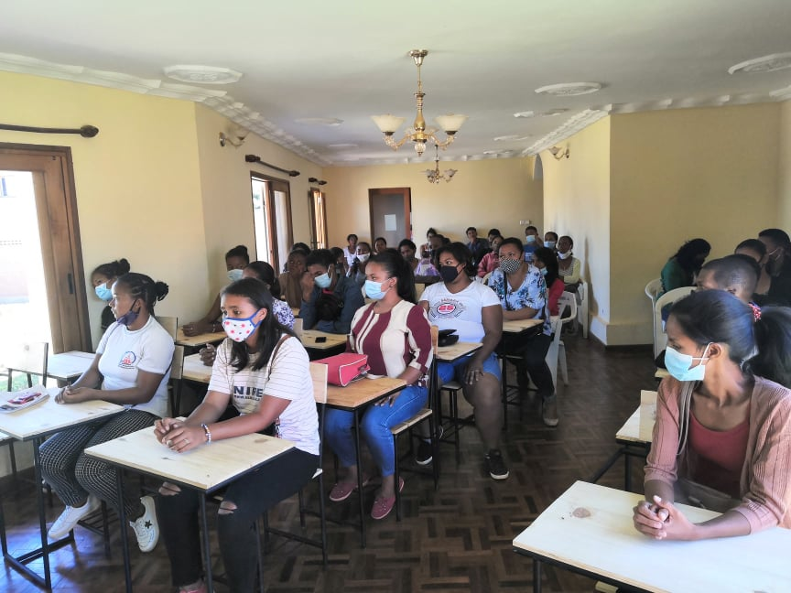
Foreign Language training
NEW PROJECT 2021
To help young people who cannot find a job. (most companies recruit young people who have mastered foreign languages ​​(French, English)
We have a center which can trains 50 young people every 3 months.
We can receive worldwide volunteers in this area.

Slide 16
Other programs
-Hospital evangelisation and encouragement 3 times a week
-Home visit after discharge from hospital
-Home Family bible study ( parents with children we knew from hospital)
-Kid’s camp (we tried our 1st experience in December 2020 and the feedback are amazing from their parents. We want to do this often): After few months/years of good relationship, some parents trust us to send their children during few days. It’s a wonderful program where children are happy to experience another life. Prayer meeting, learning, nice food, games, mercy ministry to the community where the camp is happening (childre sharing the gospel and pray for the poor family, they share a package of food for them)
-Farming Project: We plant many things and give away the production for needy people who knock our door asking for food. We also encourage family to have their little vegetable garden .

Slide 17
Current situation (January 2022)
Sunshine Project
KMCC
We have more parents coming to us because of the economic crisis caused by Covid-19.We receive more than 30 requests per day of sick children/pregnant women.
90 % of our funds are from local individual donations, followers on our social media page.
We are not well equipped to proceed for International partnership and trying to develop that side.
There are more than 2000 maternities in Madagascar, all of which care for preterm but about 90 % of them don’t have incubators. We have introduced and implemented the KMCC in 24 hospitals and maternities in the last 8 years.
Many hospitals and maternities have requested this program but we couldn’t due to lack of funds.

Slide 18
Our goals:
We want every child to benefit from their right to receive adequate care when they are sick
We want the kingdom of God in children’s life (good health, education, peace, joy, alive dreams, etc)
We work to decrease the rate of child mortality
We want hospitals to be well-equipped and become places where people can expect to be healed
We want to help pediatrics and maternity ward all around Africa where KMC is not practiced with our expertise in Kangaroo Mother Care
Steps to achieve our goals:
We keep raising awareness about our projects in our personal and professional networks
We are working on developing partnerships with local and international organizations
We are advocating for the local government to prioritize health care for children because more than 50 % of Madagascar population are under 15 years old.

Slide 19
Do you want to be part of this life-saving project with us?
You are welcome to collaborate, to volunteer, or to donate
You can also connect us with businesses, NGOs, foundations,…

Slide 20
With 5 USD you can insure a bottle of Antibiotic
With 10 USD you can provide a week's meal for the child and his mother in the hospital
With 25 USD monthly, you can sponsor a child (school fees and food aid)
With 50 USD you can ensure the treatment of a child suffering from meningitis
With 100 USD you can pay for an expensive medical examination like the scanner
With 200 USD you can cover the needs for a surgical intervention
With 1000 USD you can offer 2 hospital beds; 3 thermometer; 1 baby scale; 100 baby carrying bands and 10 practical guide books to allow a maternity hospital to properly practice Kangaroo Mother Care
…

Slide 21
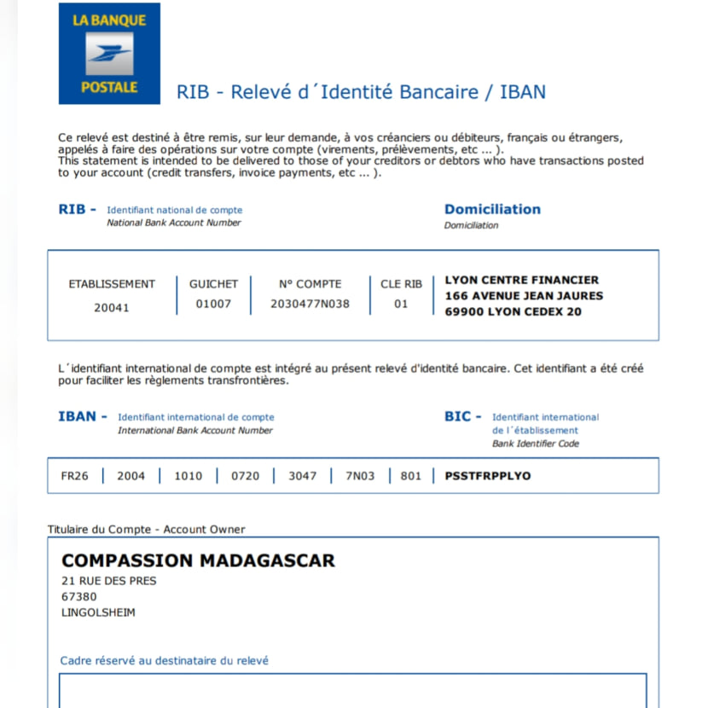
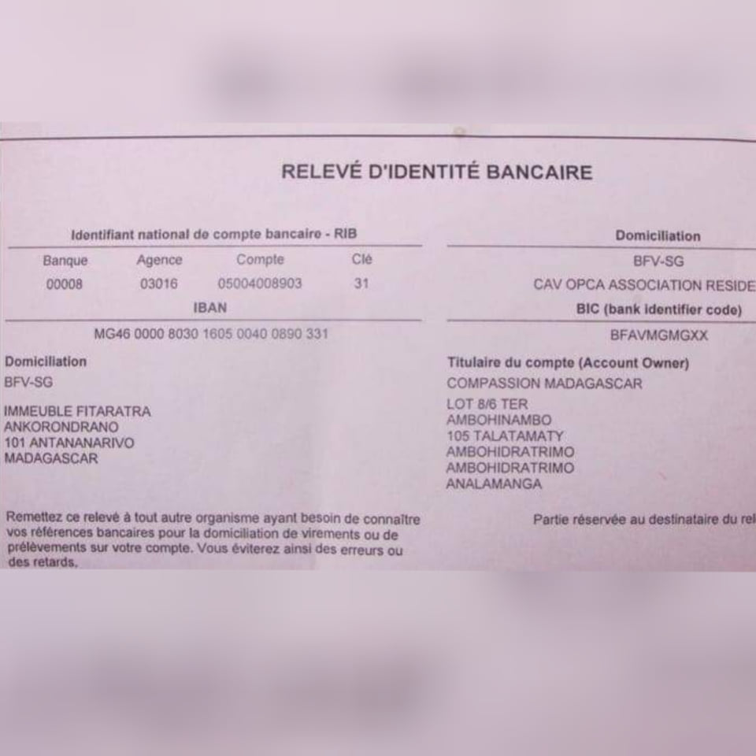
Bank account in France and Madagascar
PayPal: compassmad@gmail.com

Slide 22
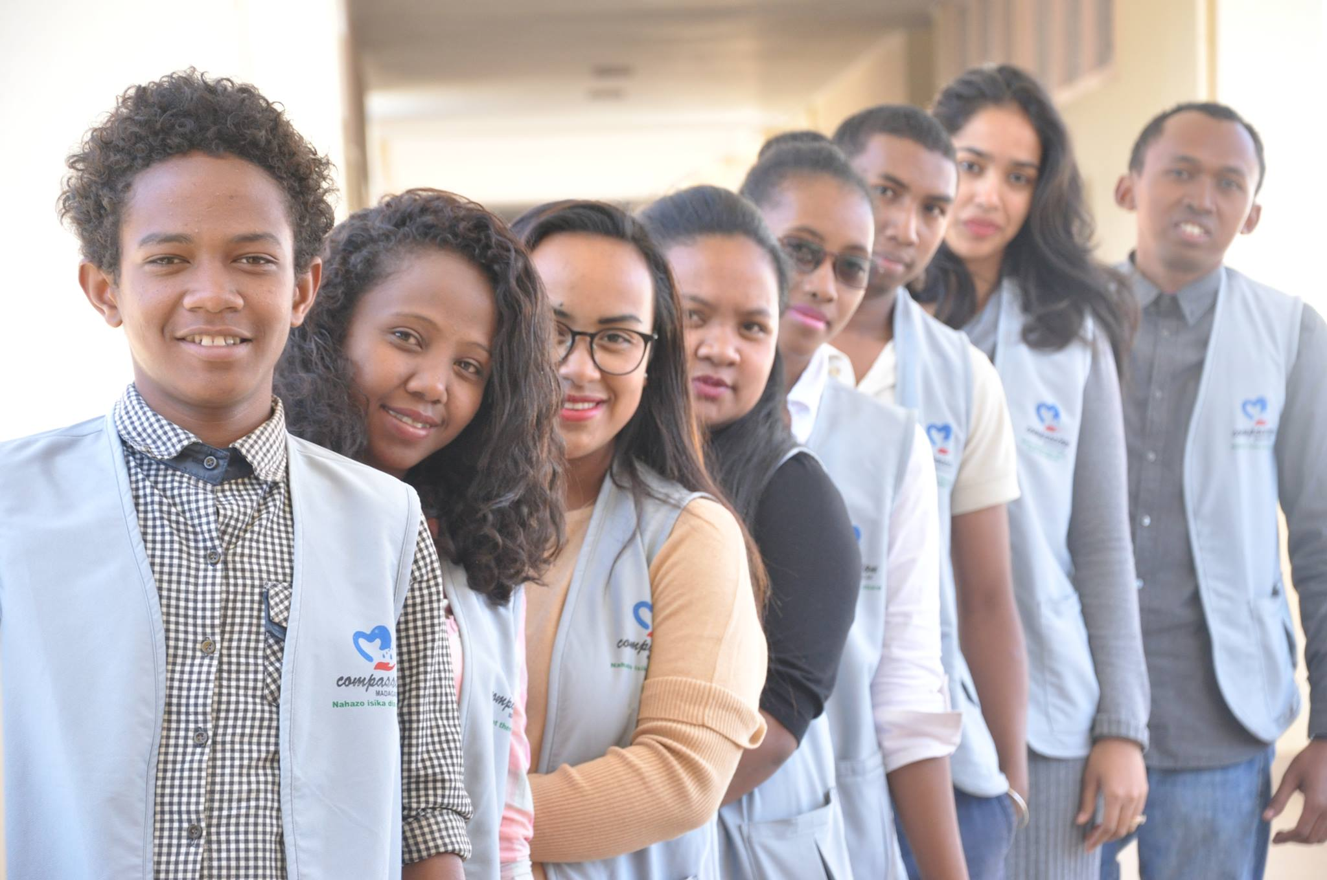
Thank you very much for your precious time!
Presented by Elodie Ranjanoro, founder of Compassion Madagascar

